Slide 1

MA478 Project Proposal
Authors:
CDT Garrett Chrisman
CDT Lucas Villanti

Slide 2

Background
"Chiraq": A Controversial Nickname
Chicago is often called "Chiraq" in hip-hop culture
Nickname reflects the city's crime and violence history
Crime Statistics in Chicago
Burglary incidence has fluctuated historically
Poverty, inequality, limited education, and job opportunities are major contributing factors
Neighborhood Disparities
Research indicates a spatial distribution of burglaries
Higher poverty and unemployment correlate with more burglaries
Affluent neighborhoods typically see fewer crimes
Understanding Crime Dynamics
Local socioeconomic factors greatly influence crime patterns
Detailed understanding of causes is essential for addressing the issue

Slide 3
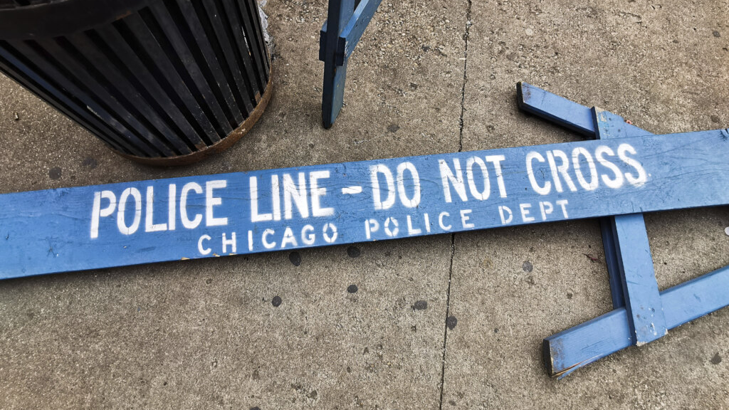
Problem Statement
Disparity in Burglary Rates
Given the noticeable disparities in burglary rates across different Chicago neighborhoods, what model can accurately capture the impact of seasonal changes, population, and wealth index on burglary counts, and account for spatial and temporal variability?

Slide 4
Sources of Variation Diagram
Observational Units: Census Block Groups in Chicago
Explained Variation Population Unemployment measure Weather Conditions (Time of Year) Measure of Youth Males
Unexplained Variation Individual criminal intent Specific local security measures Unpredicted temporal events Random local events Random effect between different districts
Response Variable: Count of Burglaries

Slide 5
Research Questions & Hypothesis
Research Question:
What are the key socioeconomic and demographic factors that influence burglary rates in Chicago neighborhoods?
How do seasonal patterns, district socio-economic profiles, and wealth indices impact the spatial and temporal variability of robbery incidence in Chicago over a seven-year period?
Hypothesis:
Higher levels of poverty and population density in a Chicago neighborhood are positively associated with higher burglary rates.
The application of a mixed-effects model, accounting for both fixed (socioeconomic status, unemployment) and random (seasonal variations) effects, will provide a more accurate prediction of burglary rates across Chicago neighborhoods than models considering only fixed effects.

Slide 6
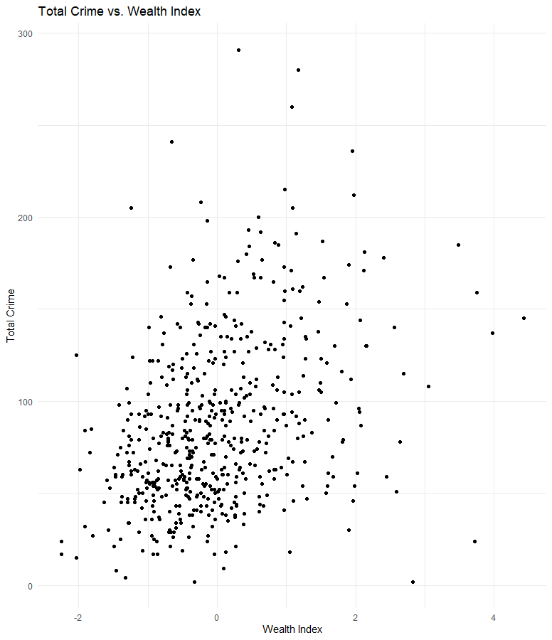
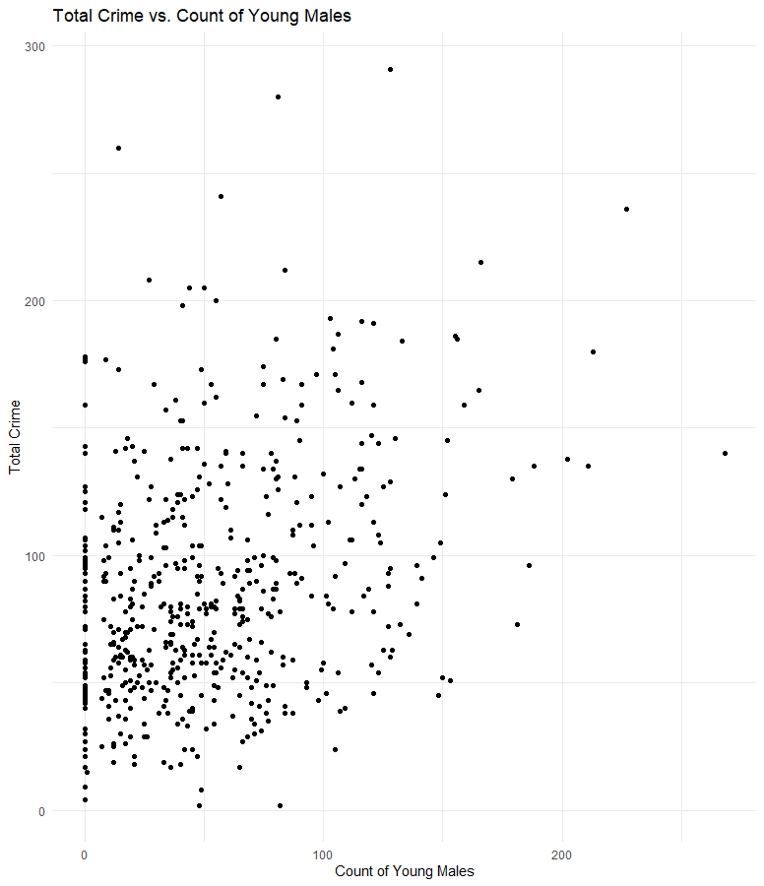
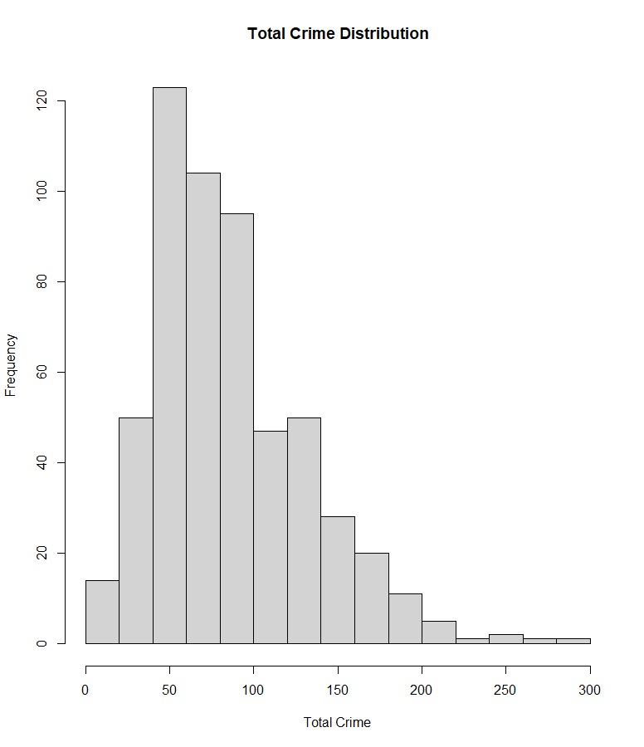
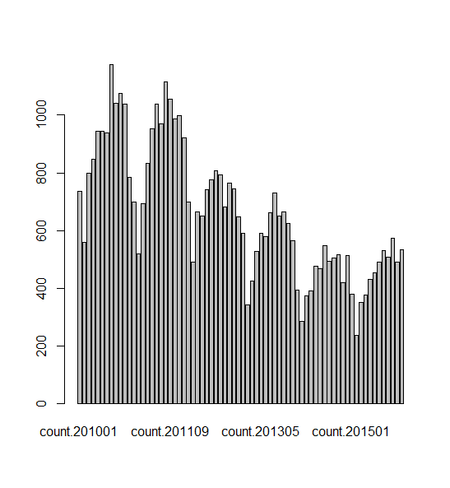
Initial Exploratory Data Analysis

Slide 7


Proposed Models
Poisson Regression
$$\log\left(λ_{i}\right)= β_{0}+β_{1}\left(Population_{i}\right)+β_{2}\left(Unemployment_{i}\right)+β_{3}\left(Wealth_{i}\right)+β_{4}\left(Measure of Young Males\right)+β_{5}(Weather Conditions)$$
$λ_{i}$ : is the expected count of burglaries in the i-th neighborhood
Mixed Effects Model
$$Y_{it}= β_{0}+β_{1}∙X_{1, itw}+β_{2}∙X_{2, itw}+β_{3}∙X_{3, itw}+ℶ_{i}+θ_{t}+ε_{itw}$$
$$t=time \left(year.month\right)$$
$$i=district$$
$$w=wealth$$
$β_{1}$​ is the coefficient for the first predictor $X_{1, itw}$, is time varying variable
$β_{2}$is the coefficient for the second predictor $X_{2, itw}$​, is specific to each district ID
​$β_{3}$ is the coefficient for the wealth index $X_{3, itw}$, the effect of wealth on the robbery count.

Slide 8
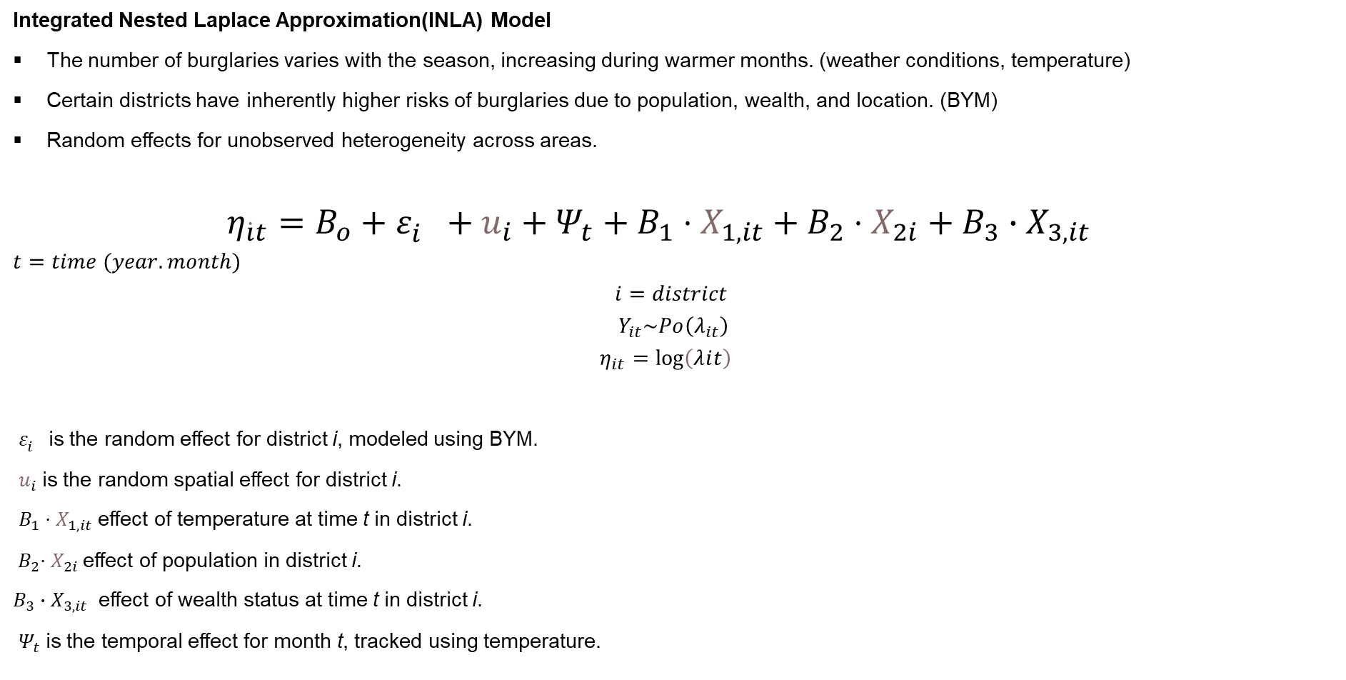
Model
Integrated Nested Laplace Approximation(INLA) Model
The number of burglaries varies with the season, increasing during warmer months. (weather conditions, temperature)
Certain districts have inherently higher risks of burglaries due to population, wealth, and location. (BYM)
Random effects for unobserved heterogeneity across areas.
$η_{\dot{i}t}=B_{o}+ε_{i}^{}+u_{i}+Ψ_{t}+B_{1}⋅X_{1,it}+B_{2}⋅X_{2i}+B_{3}∙X_{3,it}$
$$t=time (year.month)$$
$$i=district$$
$$Y_{it}\sim Po\left(λ_{it}\right)$$
$$η_{it}={\log\left(λⅈt\right)}_{}$$
$ε_{i}^{}$is the random effect for district i, modeled using BYM.
​ $u_{i}$is the random spatial effect for district i.
​ $B_{1}⋅X_{1,it}$effect of temperature at time t in district i.
${ B}_{2}⋅X_{2i}$effect of population in district i.
$B_{3}∙X_{3,it}$​ effect of wealth status at time t in district i.
$Ψ_{t}$is the temporal effect for month t, tracked using temperature.

Slide 9

Questions??

